Slide 1

MUM Life
By: Jonathan Tuta & Yadir Hernandez

Slide 2
Problem Statement
Managing and Renting items from the Recreation Center.
Managing and Getting information about events.
Notes:
Take Survey

Slide 3

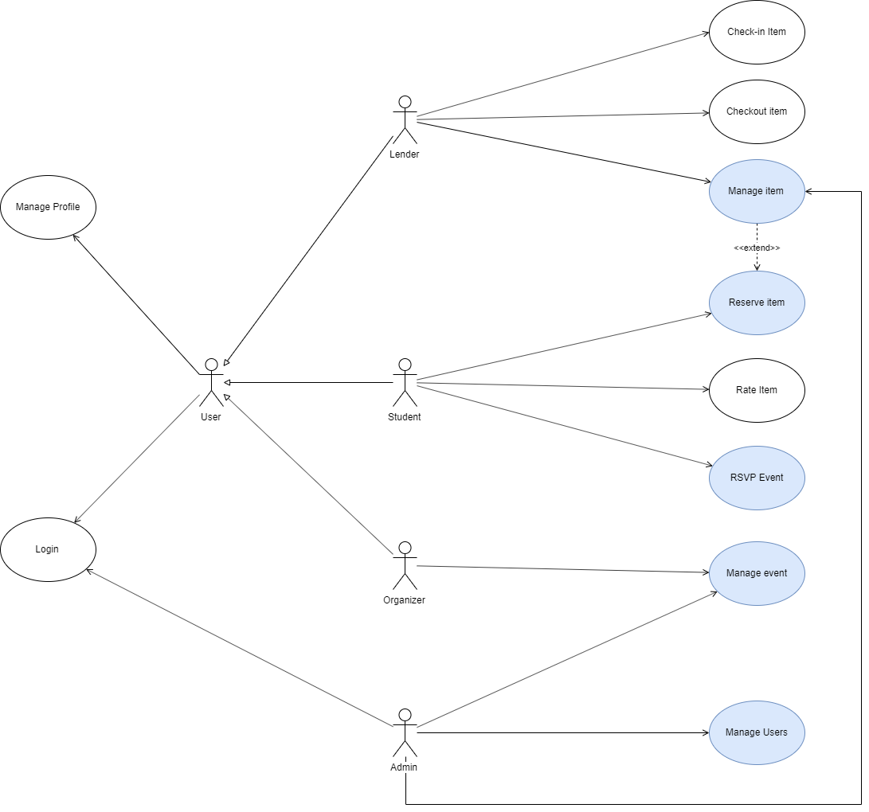
Use Case Diagram

Slide 4
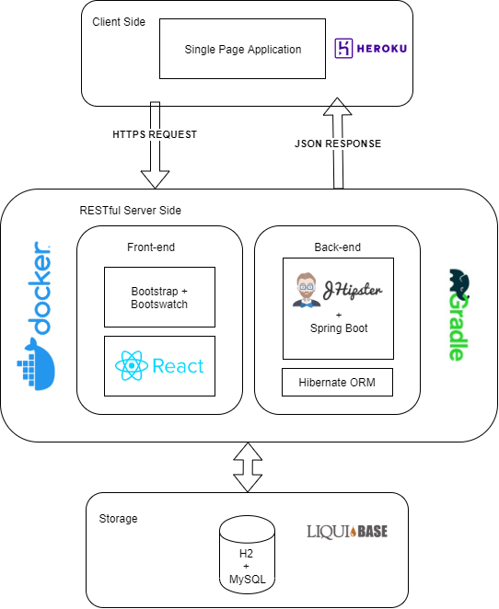
Architecture Diagram
+
Technology Stack

Slide 5
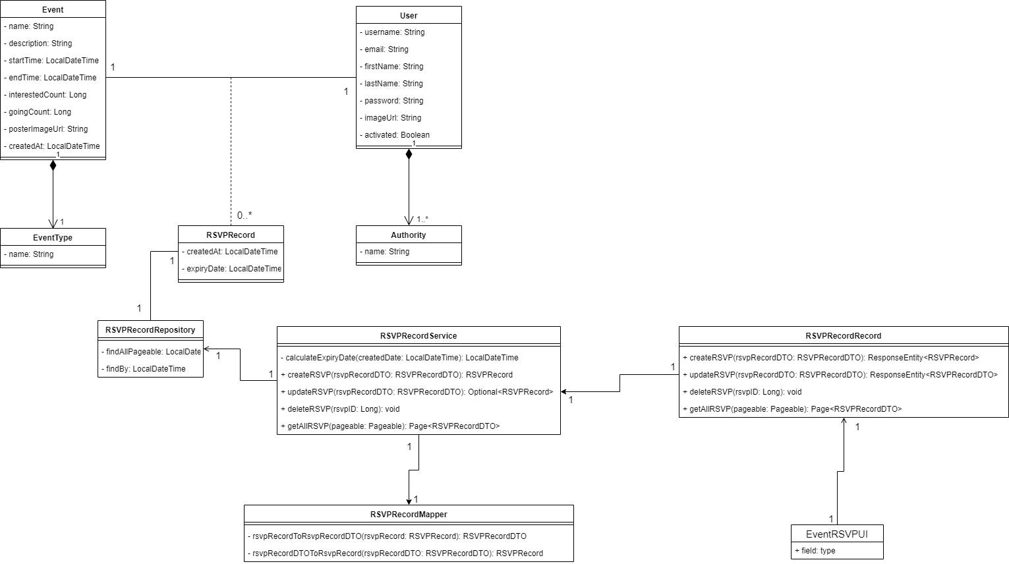
Class Diagram

Slide 6
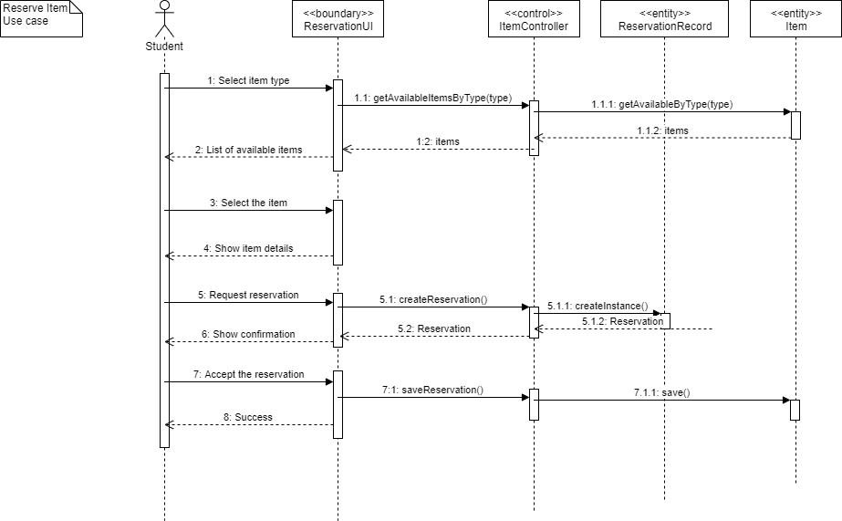

Slide 7
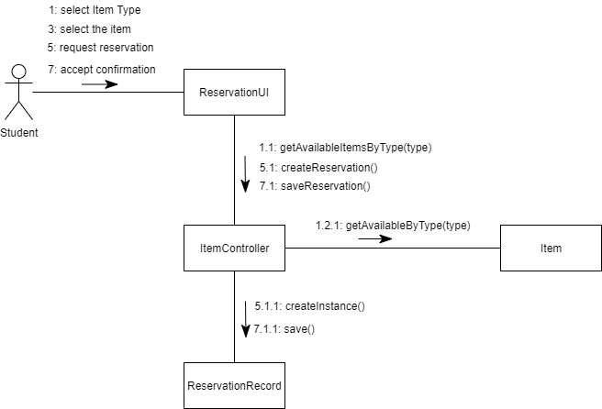
Collaboration Diagram

Slide 8
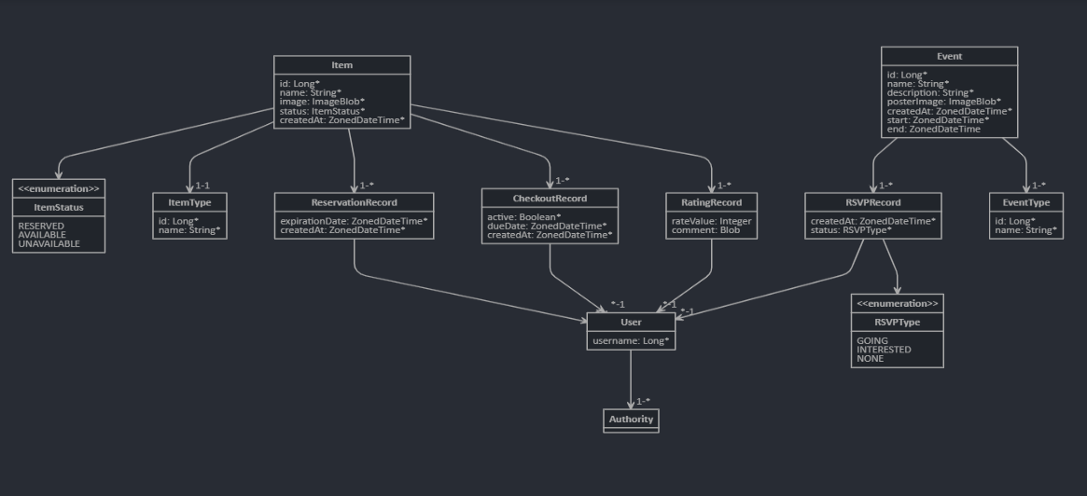
JDL Model

Slide 9
demo

Slide 10


Thank you!

